Slide 1
AUTO IRRIGATOR
Under guidance of
Mrs. Padmashree A,
Assistant Professor,
BIT,
Sathy.
Bala Preethika J - 202CB104
Naveena P - 202CB127
Swathi S - 202CB148
Sarankumar K - 202CB138

Slide 2
Abstract
Nowadays people are becoming more health conscious and trying to avoid chemicals in the food they intake. In macro agriculture, large amount of chemicals are used to increase the productivity. So, people are moving towards organic farming and rooftop agriculture. They started to cultivate fruits and vegetables for their basic needs around their house like terrace, balcony, etc. There are many problems faced during this venture. One of them is irrigating the plants daily. All the plants should be watered timely and sufficiently for their rich growth. People who have gardens are unable to go on long holidays as it would disturb the watering cycle of the plants. In order to relieve the people from the same, we have come up with a system that would water the plants on its own just by a touch. This automatic irrigation system would be equipped with Arduino, sprinkler irrigator (if not possible, a bottle irrigator). Once the user switches on the motor, the field gets irrigated. The moisture of the soil is measured using humidity sensor. If it reaches above the level the motor gets turned off automatically. If Agriculture goes wrong there's a possibility for everything else to become wrong. To avoid such mistakes, we are in need of smart agriculture or smart gardening. It would be a great benefit if our country takes steps to implement our ideas in each part of the country.

Slide 3
Problem Statement Addressed
Agriculture is the backbone of India. People depend on agriculture for their food and basic needs. Farmers are the real strugglers who put in lot of efforts to cultivate and harvest various crops. Irrigation plays a major role for the harvest of crops. Manual irrigation is very difficult , since it requires a lot of man power to irrigate. Farmers should be present directly in the fields which is not possible all the time . So we aim to promote automatic irrigator which will stimulate to on/off the motor when it is required.

Slide 4
Existing Solution to the Problem Addressed
Time Based System
Irrigation time clock controllers, or timers, are an integral part of an automated irrigation system. A timer is an essential tool to apply water in the necessary quantity at the right time.
Volume Based System
The pre-set amount of water can be applied in the field segments by using automatic volume controlled metering valves.
Open Loop Systems
In an open loop system, the operator makes the decision on the amount of water to be applied and the timing of the irrigation event.

Slide 5
Proposed Solution to the Problem Addressed
We have come up with a system that would water the plants on its own just by a touch. This automatic irrigation system would be equipped with Arduino, sprinkler irrigator (if not possible, a bottle irrigator). Once the user switches on the motor, the field gets irrigated. The moisture of the soil is measured using humidity sensor. If it reaches above the level the motor gets turned off automatically.

Slide 6
Project Work Plan
Automatic irrigation system can be constructed in such a way that it provides ease to the farmers to irrigate. The model has a wifi router which will be connected to the raspberry pi chip. To irrigate fields the water has to be pumped from well or pump set. These pump set has a motor fixed to monitor the level of watering. Code has been written in PHP which we can run in the website through front end. If wifi is connected the monitoring is limited to certain areas. If sim card is used it can be accessed anywhere using mobile data. By these ways we can implement the automatic irrigation system.

Slide 7
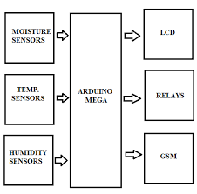
Block Diagram and/or Circuit Diagram

Slide 8
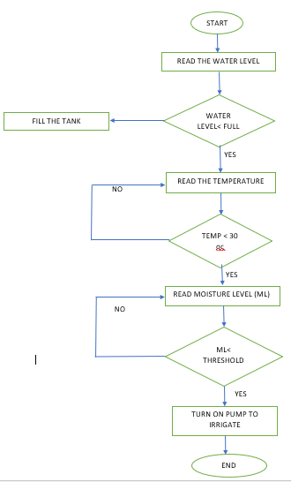
Flow Chart

Slide 9
Effective utilization of the Modern Tool & Cloud
The system uses information from the soil moisture sensor to irrigate soil which helps to prevent over irrigation or under irrigation of soil there by avoiding crop damage. The farm owner can monitor the process online through a website.

Slide 10
Technology stack & Use case
Arduino
Sprinkler irrigator
Moisture level sensor
Reduced Labor
Timely Irrigation remotely
Optimizing Energy

Slide 11
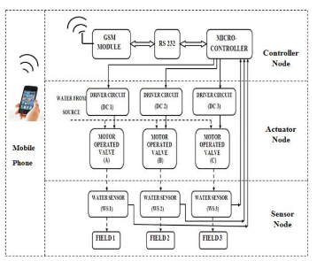
Prototype & Sample Output

Slide 12
Analysis of Results & Discussions
This system can be operated anywhere and anytime remotely. The disadvantages of automatic irrigation are costs for purchasing, installing and maintaining the equipment. Due to machines fault higher flow rates of water may occur. Applying the internet of things to the irrigation system has a significant impact on ensuring the efficient use of water resources as well as ensuring the efficiency and stability of the agricultural production. With more advancement in the field of IoT expected in the coming years, these systems can be more efficient, much faster and less costlier. In the Future, this system can be made as an intelligent system, where in the system predicts user actions, rainfall pattern, time to harvest, animal intruder in the field so that agricultural system can be made independent of human operation.

Slide 13
Cost Benefit Analysis (List of Components / Service Used)
(Budget)
S.No | Component Name | Specification (IC number or Range or Value) | Unit Cost | Total Cost
1. | Soil Moisture Sensor | 0 to 1023 | 63 | 500
2. | Humidity Sensor | 0 to 50 | 850-4000 | 850
3. | Temperature Sensor | 1000°F and 2700°F | $10-$200 | 100
4. | Aurdino Microcontroller | 0 to 1023 | 1979 | 1500

Slide 14
References
Shiraz Pasha B.R., Dr. B Yogesha, “Microcontroller Based Automated Irrigation System”, The International Journal Of Engineering And Science (IJES), Volume3, Issue 7, pp 06-09, June2014.
S. R. Kumbhar, Arjun P. Ghatule, “Microcontroller based Controlled Irrigation System for Plantation”, Proceedings of the International MultiConference of Engineers and Computer Scientists 2013VolumeII, March 2013.
Yunseop (James) Kim, Member, IEEE, Robert G. Evans, andWilliam M. Iversen, “Remote Sensing and Control of an Irrigation System Using a Distributed Wireless Sensor Network”, IEEE TRANSACTIONS ON INSTRUMENTATION AND MEASUREMENT, Volume 57, Number 7, JULY 2008.

